Slide 2
Welcome Juniors and Parents!
Get ready for Senior year now!
Great information from the College & Career Advisors from all 7 High Schools!

Slide 3
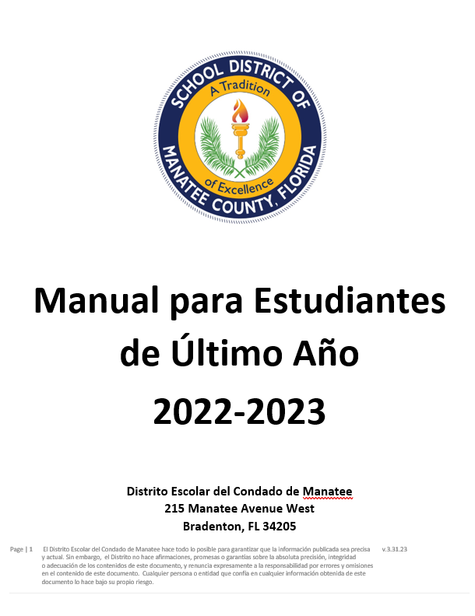
Student Handbook

Slide 4
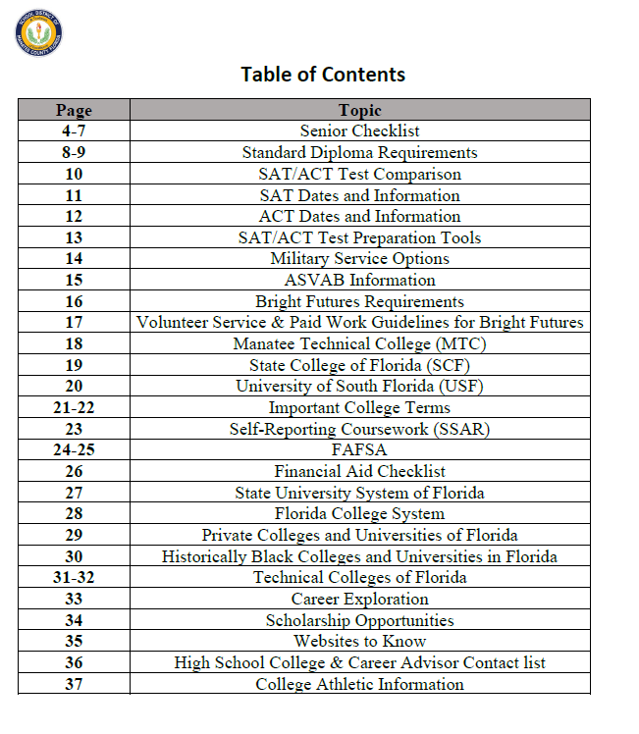
Senior Handbook
Valuable resource that includes many important topics.
The Senior Handbook is located on all High School websites & District website.

Slide 5
College Entrance Exams
Linda Norris, College & Career Advisor at Manatee High School

Slide 6
College Entrance Exams
SAT/ACT - for 4-year colleges/universities
Register/pay online
Saturday morning tests
Dates/deadlines/websites in handout
PERT – for state colleges like SCF
Basic Skills Assessment – for technical colleges like MTC; may be required for some programs

Slide 7
SAT/ACT
One of the most important steps to prepare for college
Most students take them 2-3 times
Take them NOW!
Scores are required for many colleges/universities
must be included with the admission applications
Scores are also required for Florida Bright Futures and many other scholarships

Slide 8
Practice
Free online practice on College Board and ACT websites
Familiarize yourself with the test structure, timing and types of questions
Practice! Practice! Practice!

Slide 9
Finding “Your” Perfect School
Vicki Hedgepeth, College & Career Advisor at Braden River High School
Aubrey Rife, College & Career Advisor at Parrish Community School

Slide 10
Finding “your” perfect school
Identify your priorities
Location
Size of Campus/# of students
Academic Path
Sports/extracurriculars
Cost/aid

Slide 11
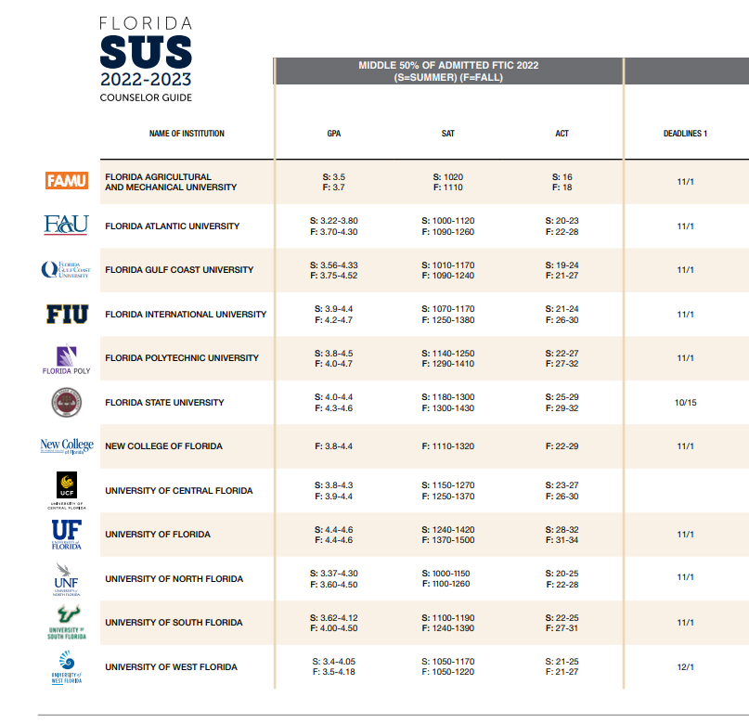
Consider Your Admissions Chances
Dream School (2)
Realistic School (3/4)
Safety School (1/2)

Slide 12
Visit the Campus
Visit in person or virtually
Look
Look at the dorms/off campus housing
Can you share a bathroom with 5 people?
Go
Go into a classroom
Can you learn in a room of 300?
Check out
Check out the town
Can you live without Starbucks/Chik-fil-a?
Visit

Slide 13
Stay Local
Manatee Technical College (MTC)
Most certificates are accomplished in less than 1 year.
Jobs are waiting. Local and national employers are waiting for the students to get certified.
Fire school, Police Academy, Massage school, welding, cyber security, culinary, CAD design, HVAC & Auto/Marine repair are just a few of the certificates offered.
State College of Florida (SCF)
Offering 2 and 4 years degrees.
Some programs are certificate and degree programs
Offers some aspects of “college life” with clubs, sports and extracurriculars
With both of these amazing options the costs are lower, and they offer financial aid. Both of these school are worth touring. You will be impressed.

Slide 14
Finding “Your” Perfect School
Do Not choose
Do Not choose a school because your best friend is going there.
Do Not choose
Do Not choose a school because your dad and uncles went there.
Do Not choose
Do Not choose a school because you like the mascot.
CHOOSE
CHOOSE the school that feels right to you and offers almost everything you want.

Slide 15
Resumes, College Applications, & Letters of Recommendation
Dr. Carmen Purpus, College & Career Advisor at Lakewood Ranch High School

Slide 16
Why have a Resume?
College applications
Scholarships
Employment
Internships
Letters of recommendation

Slide 17
Resume
4 Key Parts:
A high school student's resume will look slightly different from a professional one. These are the sections to include in the suggested order they should appear:
1. Education
Students can list their high school, but it should also include achievements, such as being on the honor roll or taking advanced courses.

Slide 18
Resume cont’d
2. Experience
Previous job experience - can include babysitting, lawn mowing, etc.
3. Skills
List computer and online research skills, customer service, communication, and detail-oriented skills
4. Activities
Extracurricular activities and volunteering can set a student apart from others. Even if a student only volunteered for one semester, that's still a relevant experience to include.

Slide 19
Resume, cont’d
Note:
Use action verbs—assisted, helped, arranged, managed—to describe the student's previous experiences. These words help the employer visualize the student as actively involved.
motivated
assessed
demonstrated
contributed
aided
chaired

Slide 20
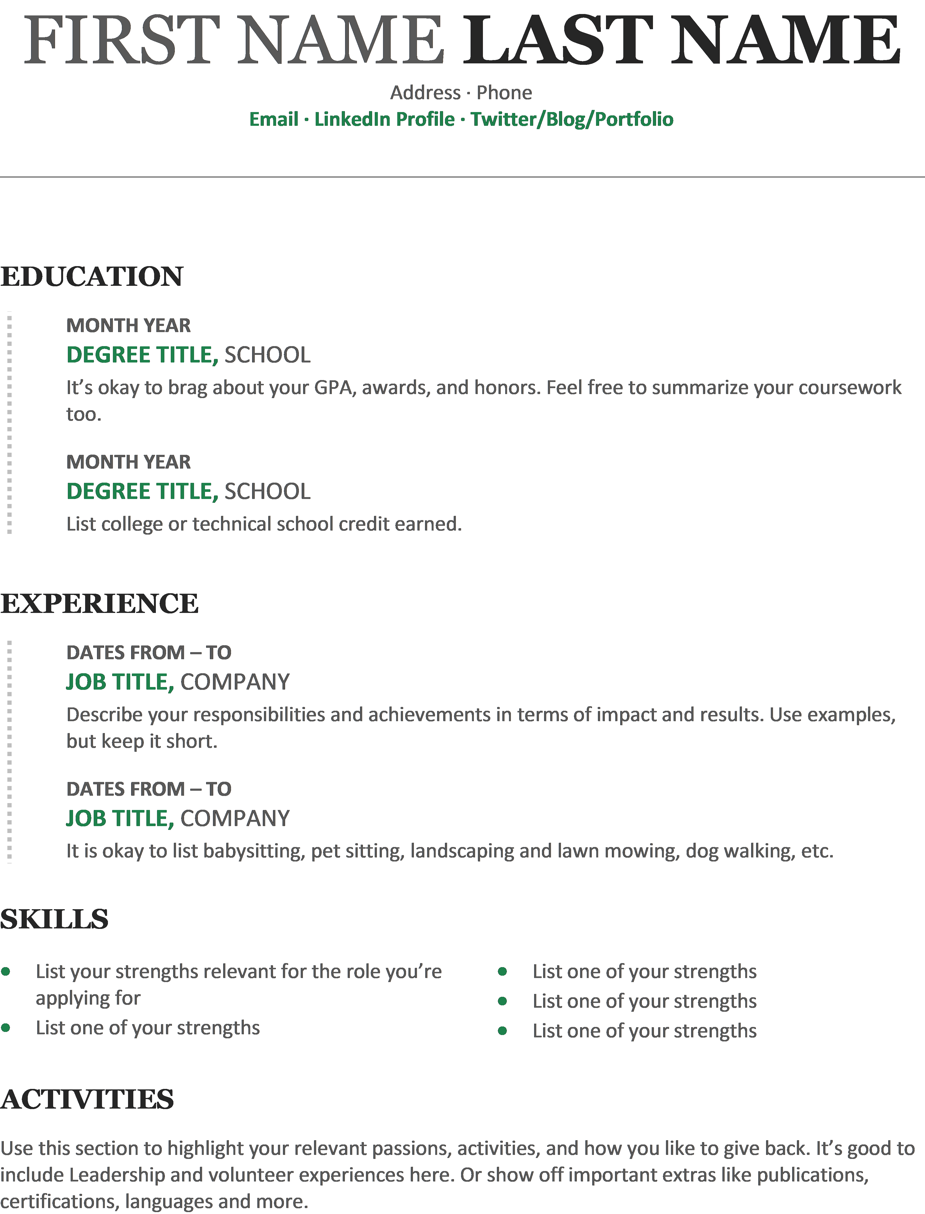
Sample Resume
Sample Student Resume
Sample Student Resume.pdf

Slide 21
College Applications
Create a list of 3-6 schools.
Create a Common App account.
The Common App allows you to apply to multiple schools at once.
Nearly 700 colleges and universities
All 4-year Public Universities in Florida accept The Common Application except for Florida International University (FIU), own institutional application.
“Now is a great time to start exploring the application so you know what questions you’ll be asked. You can create a Common App account at any time, and your account can rollover from year to year, using the same username and password."
https://www.commonapp.org/plan/your-path-to-college/11th-grade

Slide 22
College Applications Cont’d
When should I apply to college?
Submit Early Decision Applications in early Fall of senior year – typically by November 1.
Response usually by mid-December
Withdraw all other applications.
Submit Early Action Applications in late Fall of senior year – typically by December 1. Commit by May 1st.
Submit Regular Admissions in early spring: typically, by March 1.
Submit Rolling Admissions year-round – no hard deadline.
Early Decision (binding) vs. Early Action (non-binding)
ED and EA facts

Slide 23
College Applications
Factors that Most Affect Admission Decisions:
Courses taken
Grades received
Class rank
Standardized test scores
Personal statements and essays
Recommendations
Extracurricular activities
Florida Application Deadlines

Slide 24
Letters of Recommendation
Allow the students’ prospective colleges to see the student through the eyes of a trusted teacher, counselor, or mentor.
Whom to ask?
Counselor
Teacher
Other
Note:
Some schools have specific recommendations for whom you should ask to write letters on your behalf.

Slide 25
Letters of Recommendation – Cont’d
How to Submit Your Letters of Recommendation Through the Common App
Steps:
Choose and ask people to submit a letter of recommendation on your behalf (by email or in person).
Email them your resume, college list, and other information about you to give them more context.
After August 1st, log into the Common Application website, and add your recommenders to your “Invite and Manage Recommenders” list.
Your recommenders will be invited to create an account and to submit their letter of recommendation online.

Slide 26
How to Pay for College
Rui Fernandes, College & Career Advisor at Palmetto High School
Brooke Corbett, College & Career Advisor at Palmetto High School

Slide 27
How to pay for college
FAFSA - Free Application for Federal Student Aid– need-based, completed October of senior year
Florida Bright Futures – merit-based
GPA, SAT/ACT test scores, community service
Make sure you are on track to meet the requirements
Institutional Aid – from the colleges
Private Scholarships – from national and local organizations
FL Pre-Paid
Family Members

Slide 28
How to pay for college
FAFSA
What you will need to complete Financial aid:
Valid Social Security Number
Must be a citizen or a permanent Resident (Green Card)
2022 W-2 Forms and other records of money earned during that year
2022 Federal Income Tax Return
Create FSA ID for yourself and Parents

Slide 29
How to pay for college
Bright Futures:
Go to www.FloridaStudentFinancialAid.org and fill out application.
Seniors apply between October 1st and graduation day.
There are three award levels they are:
Florida Academic Scholars Award (FAS)
Florida Medallion Scholars Award ( FMS)
Florida Gold Seal Vocational Award (GSV)
Next Slide is the breakdown for each level

Slide 30
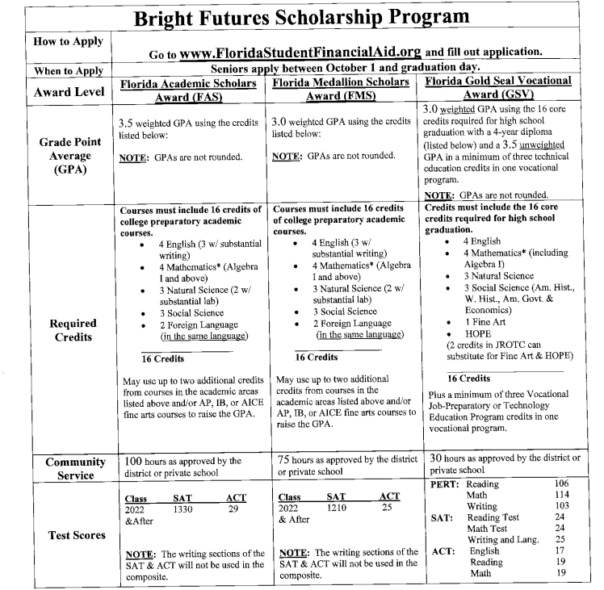
How to pay for college

Slide 31
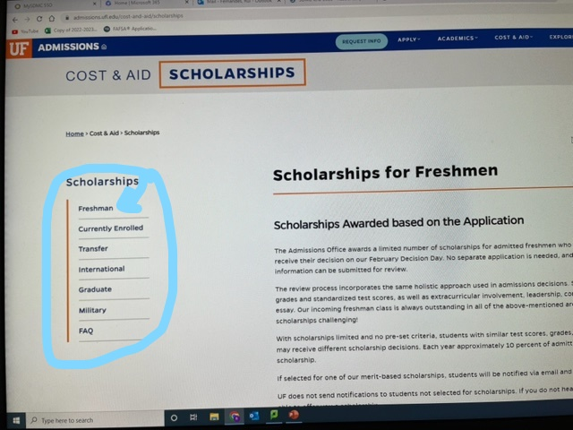
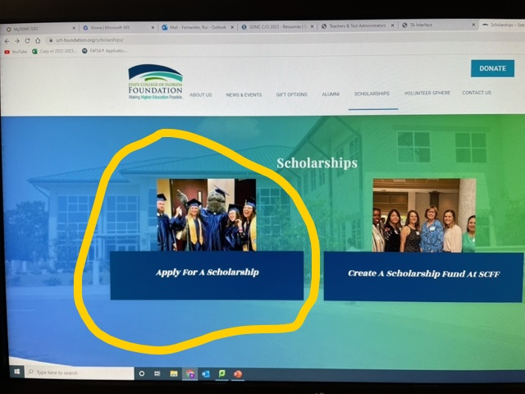
How to pay for college
Institutional Aid:
Every university has foundation scholarship page.

Slide 32
How to pay for college
Private Scholarships/FL-PrePaid/Family :
Each school has a schoology group based on your Graduation year. It’s on your specific page that you will find most of the private scholarships sent by your College and Career Advisors
The FL-PrePaid is a program offer by the state of Florida in which parents can pay monthly for a student’s post secondary school. Here is a quick video to explain what it is:
https://youtu.be/8expdA3WDtA

Slide 33
Important Dates to Remember
Kali Anges, College & Career Advisor at Southeast High School
Vicki Divitro, College & Career Advisor at Bayshore High School

Slide 34
Important Dates to Remember
September
Narrowing Down Your Choices
Create a List of 3-5 Options and Schedule Visits
Take the SAT/ACT Again-Know the GPA and Score Ranges of the Schools on your list
Request Unofficial Transcripts for College Applications
Start looking for scholarship opportunities (Local, State and National)
October
Request 2 or more recommendation letters from a teacher, counselor, or community member
Submit Applications to Schools on your list and to the Common Application
Create a Brag Sheet or Resume
Monitor Scholarship Deadlines
November & December
Finalize Application(s) and Sign-Up for College Portals
Monitor Scholarship Deadlines
Collect 2022 Tax Information to Complete FAFSA in December or January (Date TBD)

Slide 35
Important Dates to Remember
January-April
Acceptance Letters and Financial Aid Offers arrive
Check to make sure the school(s) on your list do not need a mid-year transcript
Review Acceptances and Compare Financial Aid Offers
May 1st
Submit your answer to the school you will be attending

Slide 36
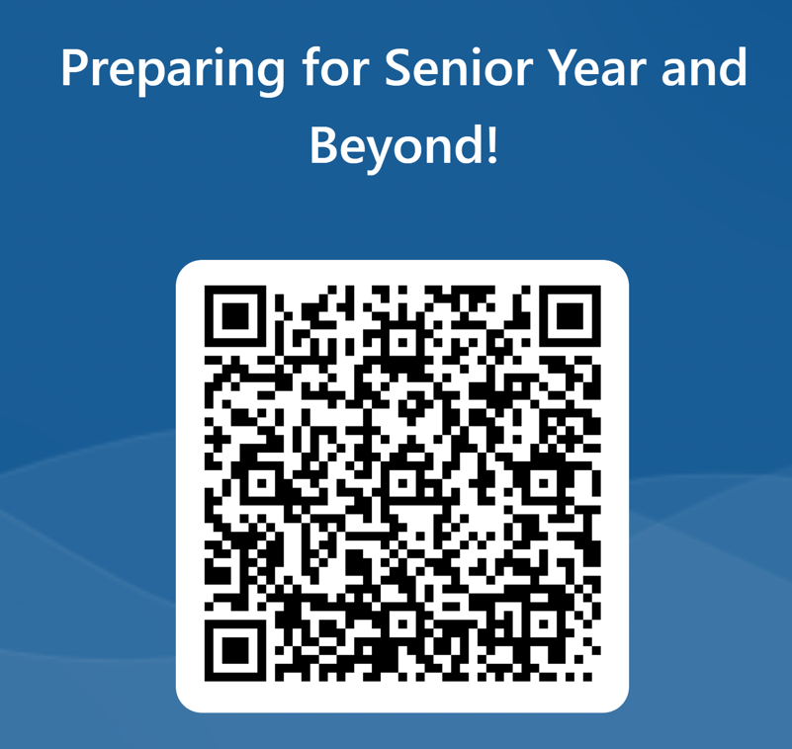
Questions???

